Slide 1
Atelier presentatie
Chantalee Vogtschmidt

Slide 2
Damien Hirst
Hirst’s life-long investigation into our almost-spiritual relationship with the rigours of science and the pharmaceutical industry.
He explains: “Pills are a brilliant little form, better than any minimalist art. They’re all designed to make you buy them… they come out of flowers, plants, things from the ground, and they make you feel good, you know, to just have a pill, to feel beauty.

Slide 3
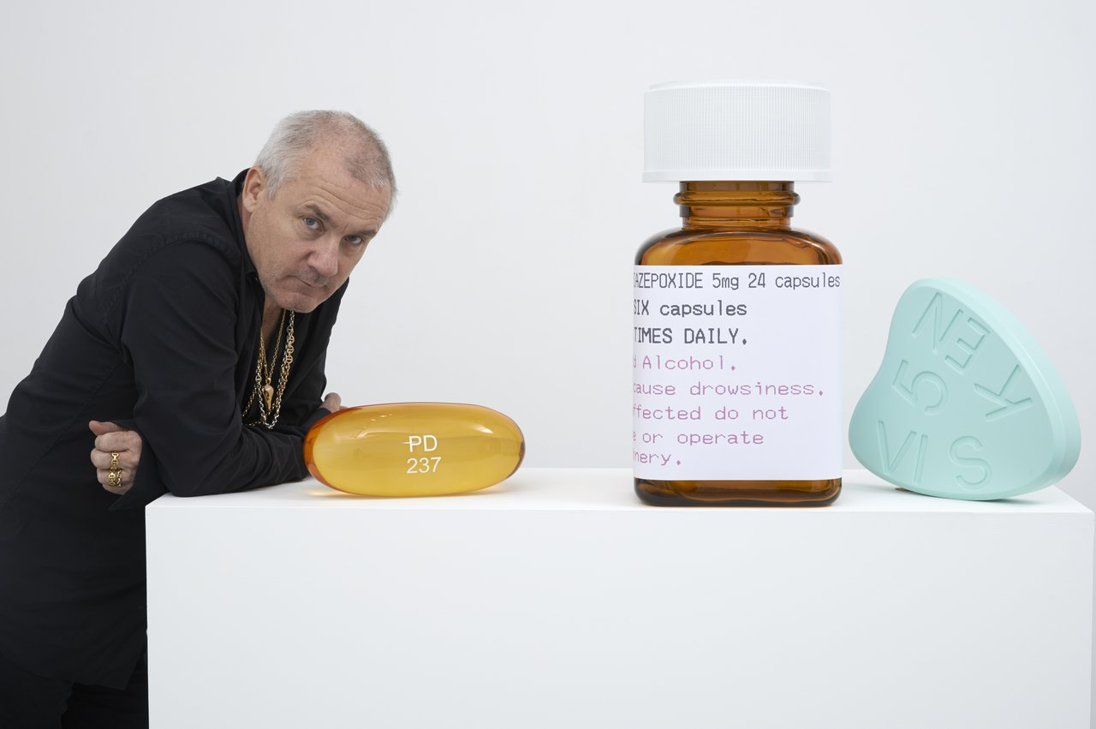

Slide 4
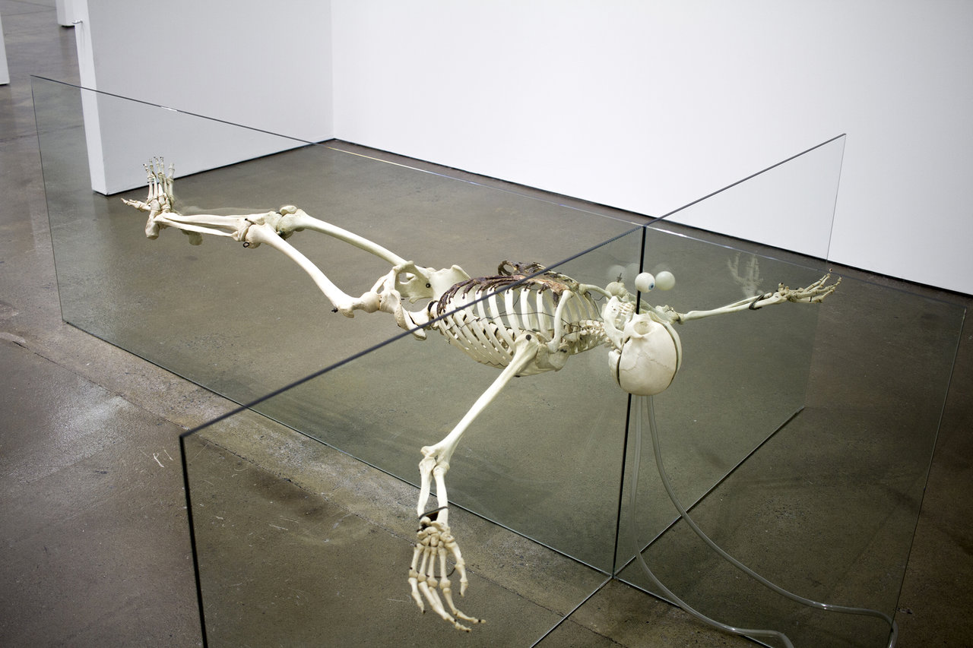

Slide 5
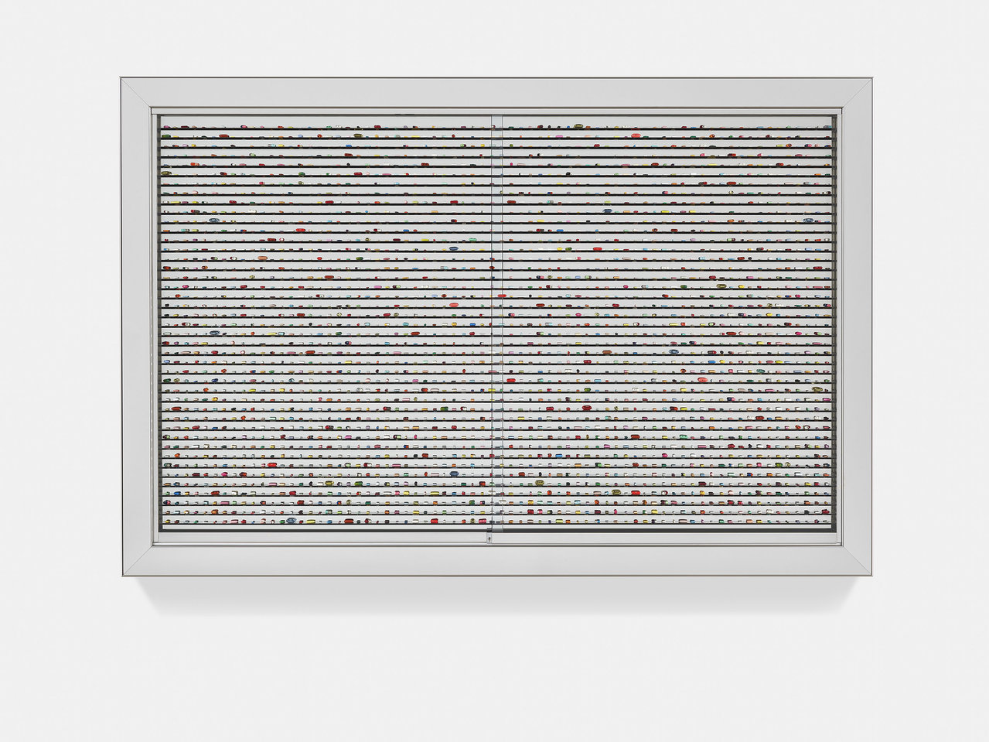

Slide 6
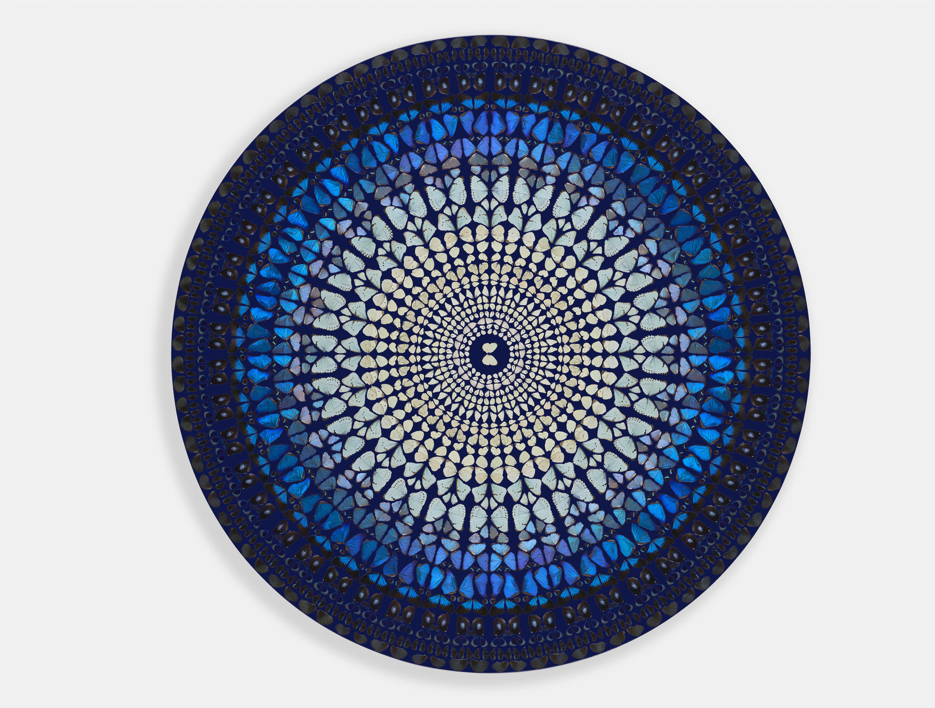

Slide 7
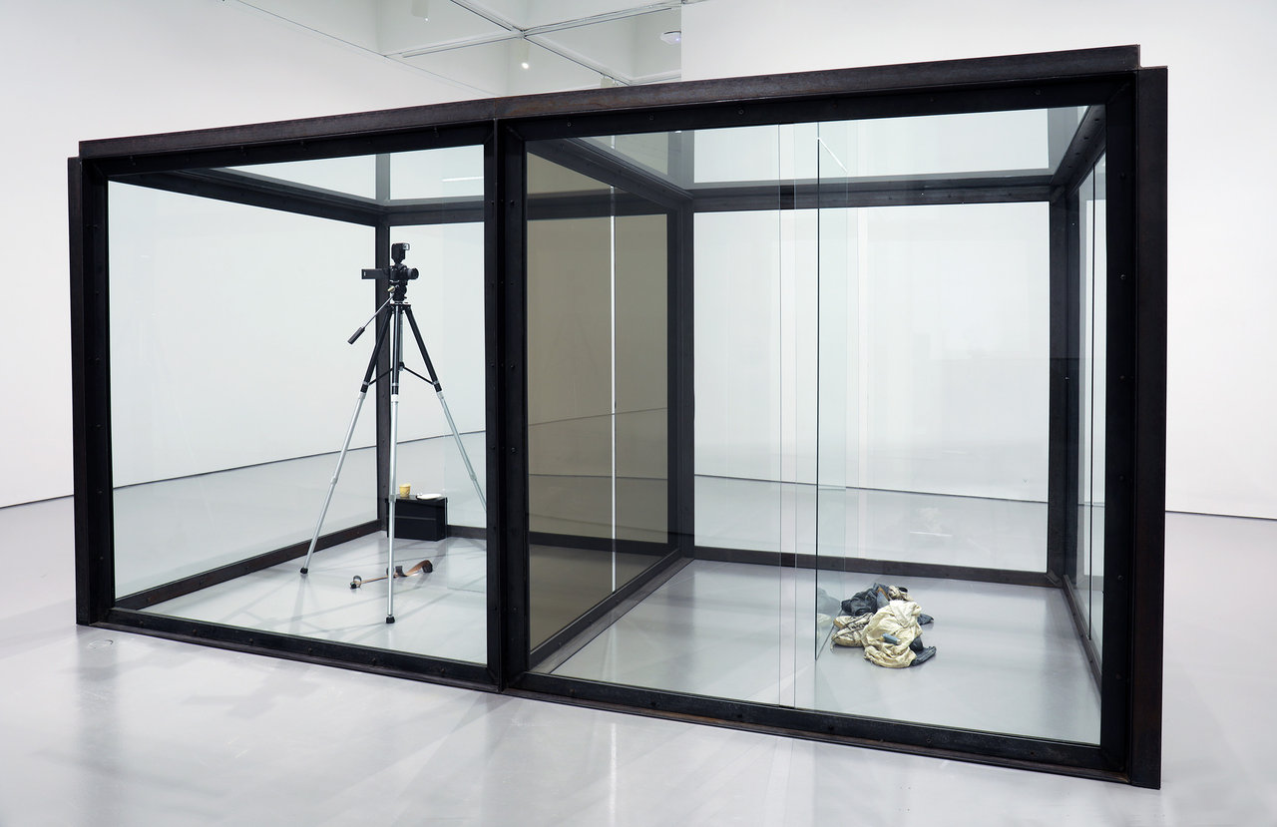

Slide 8
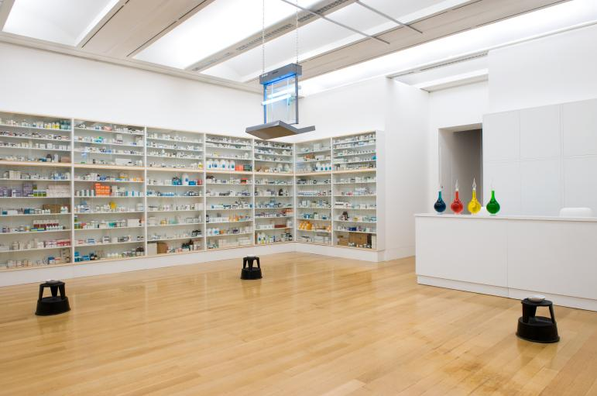

Slide 9
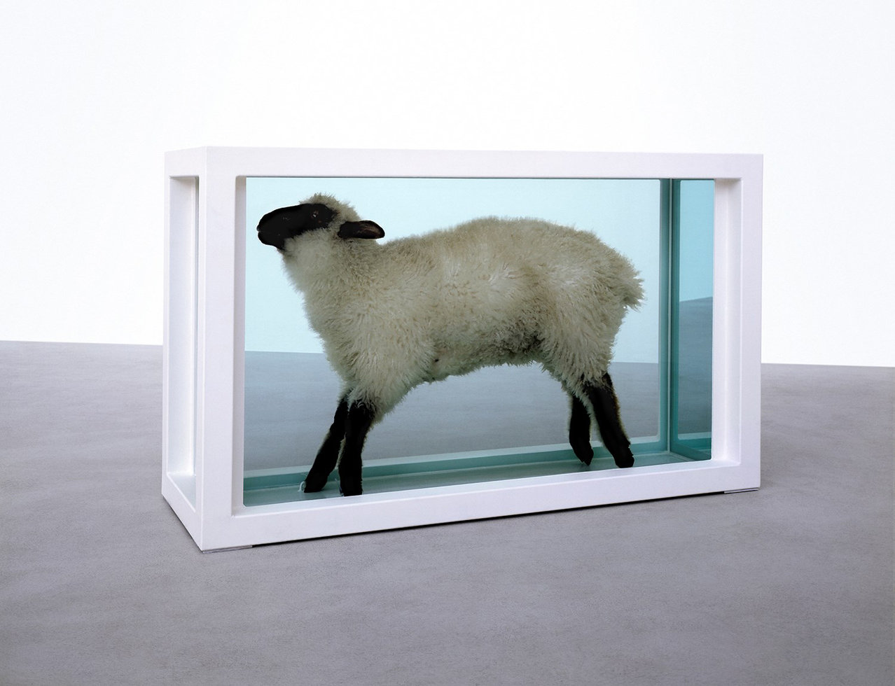

Slide 10
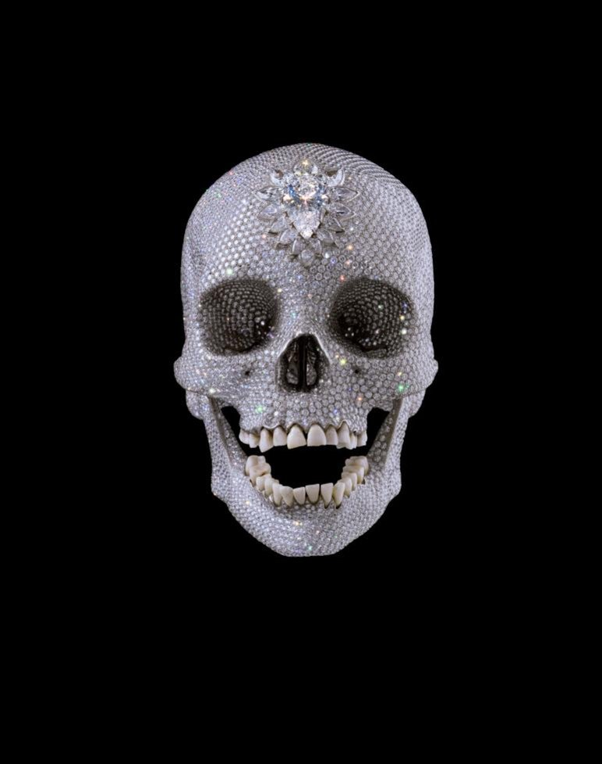
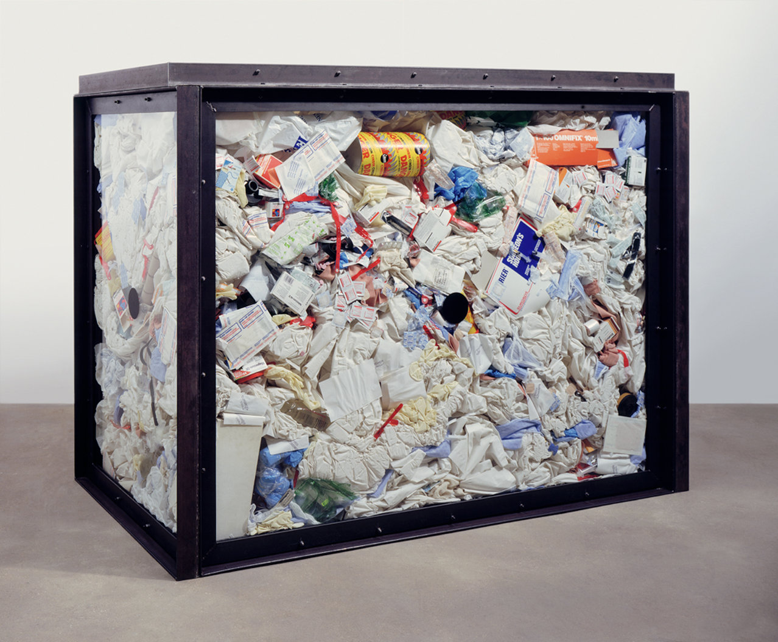

Slide 11
Medicine Cabinets
13 medicijnen kastjes
Verschillende namen zoals: Sinner, holiday, no feelings
The works explore the distinction between life and death, myth and medicine. Hirst notes: “You take a medicine cabinet and you present it to people and it’s just totally believable. I mean a lot of the stuff is about belief, I think, and the ‘Medicine Cabinets’ are just totally believable.”

Slide 12
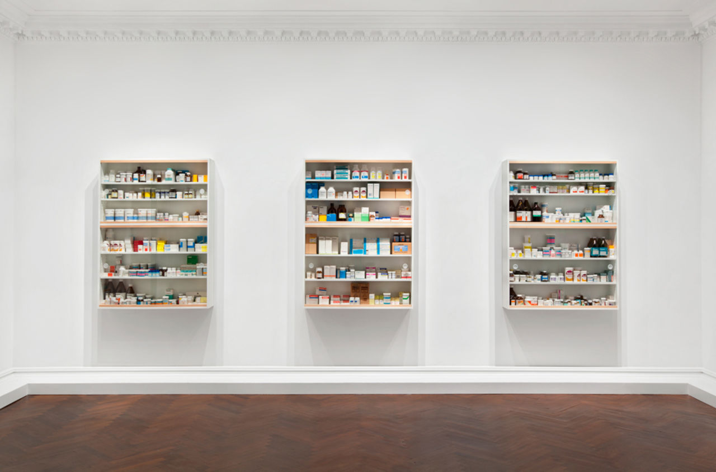

Slide 13
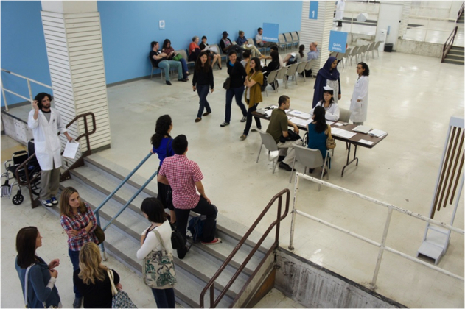
Pedro Reyes (Sanatorium)
SANATORIUM is een tijdelijke kliniek die korte, onverwachte therapieën biedt. De enige manier om dit project te ervaren is door u aan te melden als patiënt

Slide 14
https://www.youtube.com/watch?v=uZfZw9BFlzs https://www.youtube.com/watch?v=BemYpzQDi40

